Slide 1
Testability
Logging
Simple Constructors
Fewer Dependencies (Isolation)
API’s
Code with a purpose
Redundant code
Code smells

Slide 2
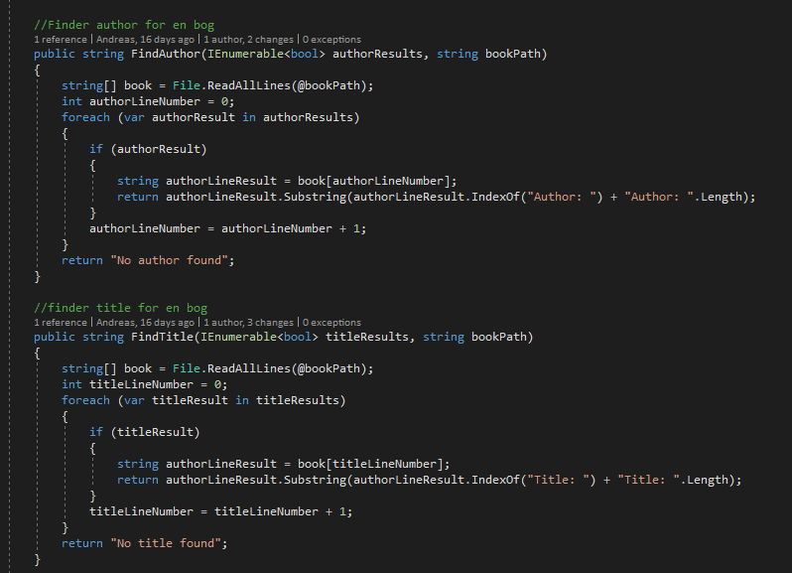
Testability

Slide 3
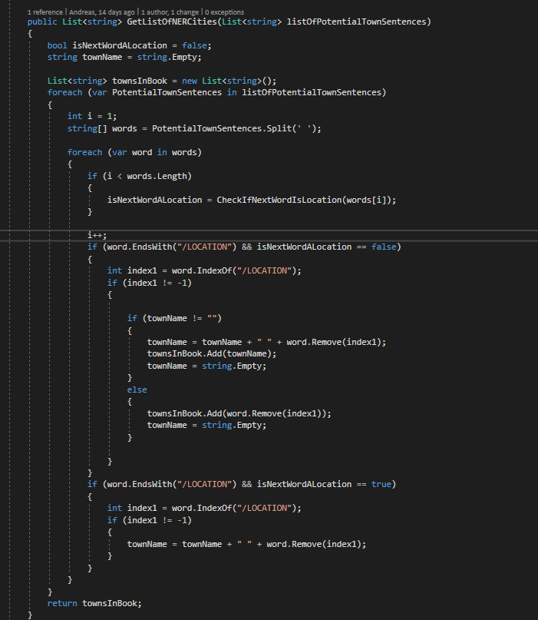
Testability

